Slide 1
Fashion sales Financial Analysis
Business Performance Insights & Recommendations
Prepared by Aarti Tungar

Slide 2
Dashboard Overview
This analysis provides a strategic overview of business performance metrics using Tableau dashboards.
Key KPIs:
• Sales Analysis by Product
• Top and Loyal Customers
• Revenue by Payment Method
• Trend Forecasting

Slide 3
Key Insights
• High variation in product performance—some items vastly outperform others.
• A small segment of customers contributes disproportionately to sales.
• Loyal customers give consistently high review ratings (avg > 40).
• Sales trend dips mid-year and recovers toward the end.
• Slight preference for cash over credit card payments.

Slide 4
Recommendations
• Promote top-selling products through ads & bundles.
• Offer loyalty rewards to top customers.
• Investigate mid-year performance dips and adjust marketing.
• Encourage payment methods that benefit margins.
• Analyze reviews to maintain product quality and reputation.

Slide 5
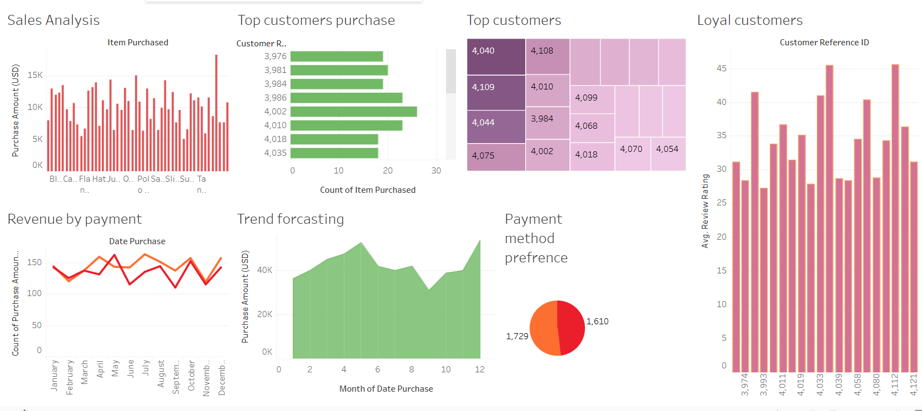
Dashboard Snapshot

Slide 6
Thank-you
Any Questions??

